Slide 1


Arduino Workshop
Introduction To arduino – Phase 1
Date : March 11th and 12th 2017
Conducted By Nikhil and Hariraj

Slide 2
Chapter 1 : Familiarization with arduino
1. History of microcontroller development platform.
2. Arduino’s Hardware and Software.
3. Different Types of arduino(s).

Slide 3
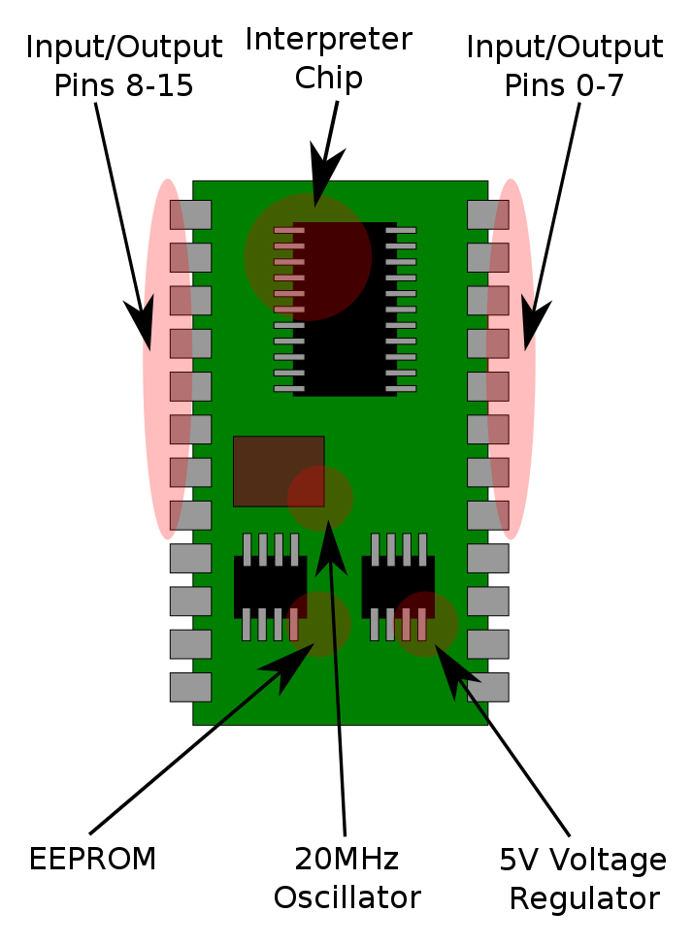
HISTORY
The origin of the Arduino project started at the Interaction Design Institute Ivrea (IDII) in Ivrea, Italy in the year of 2005.
Before that time, the students used a BASIC Stamp type of microcontroller developer platform at a cost of $100, a considerable expense for many students.
Basic Stamp 2

Slide 4
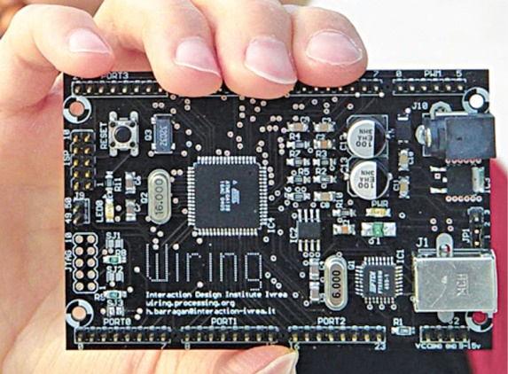

In 2004, Colombian student Hernando Barragán created the development platform Wiring as a Master's thesis project at IDII, under the supervision of Massimo Banzi and Casey Reas.

Slide 5

In 2005, Massimo Banzi, with David Mellis, another IDII student, and David Cuartielles, added support for the cheaper ATmega8 microcontroller to Wiring. But instead of continuing the work on Wiring, they copied the Wiring source code and renamed it as a separate project, called Arduino.
Founders of Arduino

Slide 6
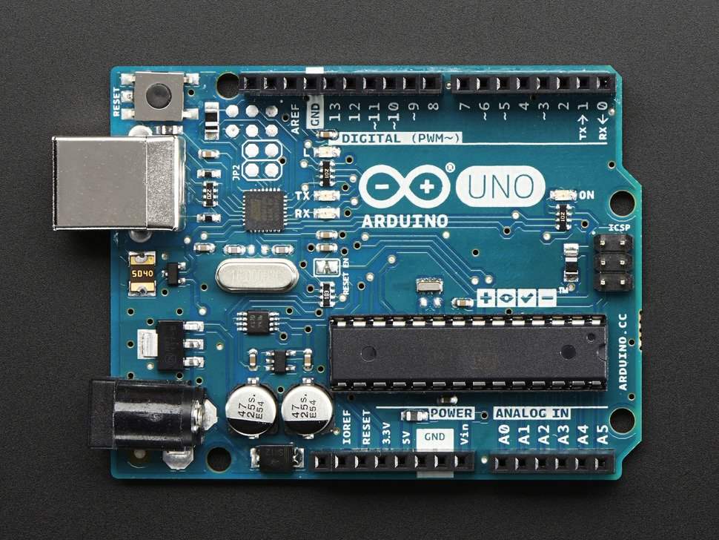
Finally The “Ahr – DwEE – no” ( Arduino )
And
The Italian word ‘Arduino’ is derived from GERMAN meaning BRAVE FRIEND.

Slide 7
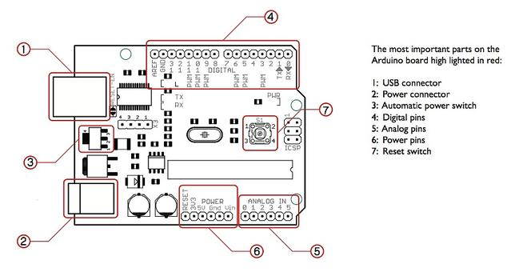


Overview of arduino uno
Atmega328/P

Slide 8
Arduino UNO’s Hardware
Basically Arduino is an Open Source microcontroller development hardware.
Classification of Arduino Uno Pins
1.Digital Input / Output (I/O) pins.
2.Analog Input pins.
3.Pulse Width Modulation ( PWM ~ ) pins.
4.Power pins.

Slide 9
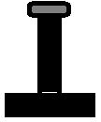
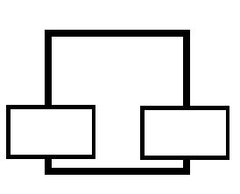
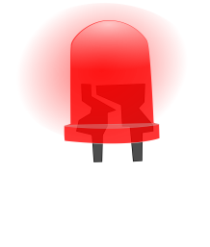
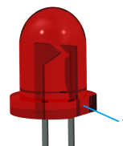
Digital Input / Output (i/o) Pins
These Digital I/O Pins (2 to13) is used to deliver 5V and 0V when initialized as output and reads voltage applied ( either 5V or 0V) when assigned as input.
+5v
SWITCH
Max DC Current per I/O pins is “20mA”.

Slide 10
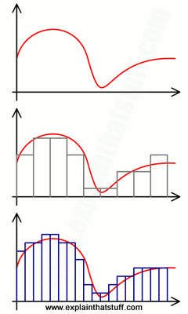
Analog input pins
Analog Pins A0 to A5 (6 pins) are used to read Analog data ( data which varies from
0V to 5V) from external sensor.
Gist of ADC’s working :-)
SAMPLING..
ADC – Analog To Digital Convertor
Discrete Sampling
Analog Signal

Slide 11
Pulse Width Modulation (PWM~) Pins
In UNO , Digital pin
3, 5,6, 9, 10, 11 can also
be used for PWM.
Basically by using PWM we can vary output voltage between 0V and 5V.
PWM is denoted using ‘ ~ ’ symbol in Arduino.

Slide 12
Power Pins
Pin 5V and 3.3V ,
Provides 5V and 3.3V respectively for powering external circuits.
GROUND (GND) ,
Provides Lowest voltage for external
circuitry (ie , 0V).
Max DC Current for 3.3V Pin is “50mA”.

Slide 13

Arduino’s SOFTware
The open-source Arduino Software (IDE) makes it easy to write code and upload it to the board. It runs on Windows, Mac OS X, and Linux.
The environment is written in Java and based on Processing and other open-source softwares.
Latest Software Version
ARDUINO 1.8.1
Updated on 01.09.2017

Slide 15
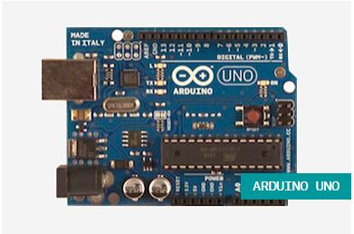
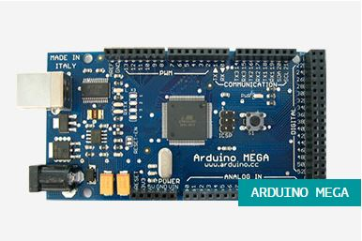
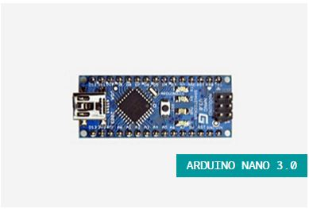
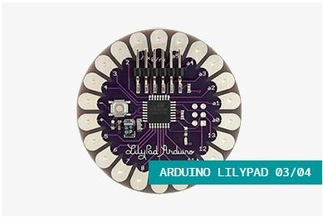
Types of Arduino(s)
The Arduino LILYPAD 04
Basic Arduino UNO with USB.
The Arduino MEGA
The Arduino Nano 3.0
And many more…

